Slide 1
EMERTXE Internship
On IOT
By,
Name: Pranjali s
USN Number: 1CR19IS107
COLLEGE NAME: CMR INSTITUTE OF TECHNOLOGY,Bengaluru

Slide 2
C PROGRAMMING

Slide 3
INTRODUCTION
C is a general-purpose, middle-level, compiler-based and procedure or function-oriented structured programming language. It was developed by Dennis Ritchie in 1972 at Bell Laboratories.
C evolved from three previous languages ALGOL, BCPAL and B. C uses many of the important concepts of these three languages.

Slide 4
APPLICATIONS
System Software Development
Embedded Software Development
OS Kernel Development
Firmware, Middle-ware and Driver Development
File System Development

Slide 5
KEYWORDS
char
int
for
while etc.

Slide 6
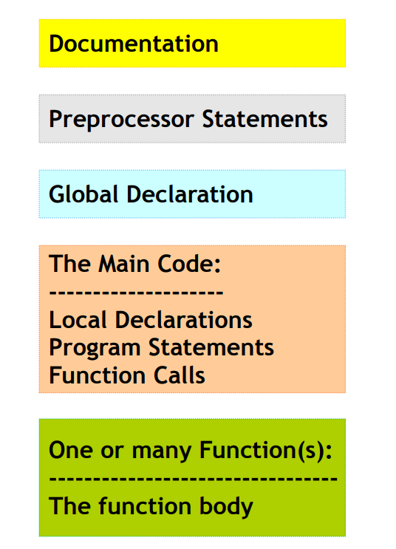
SYNTAX

Slide 7
DATA REPRESENTATIONS
BIT
BYTE
WORD
NUMBER SYSTEMS

Slide 8
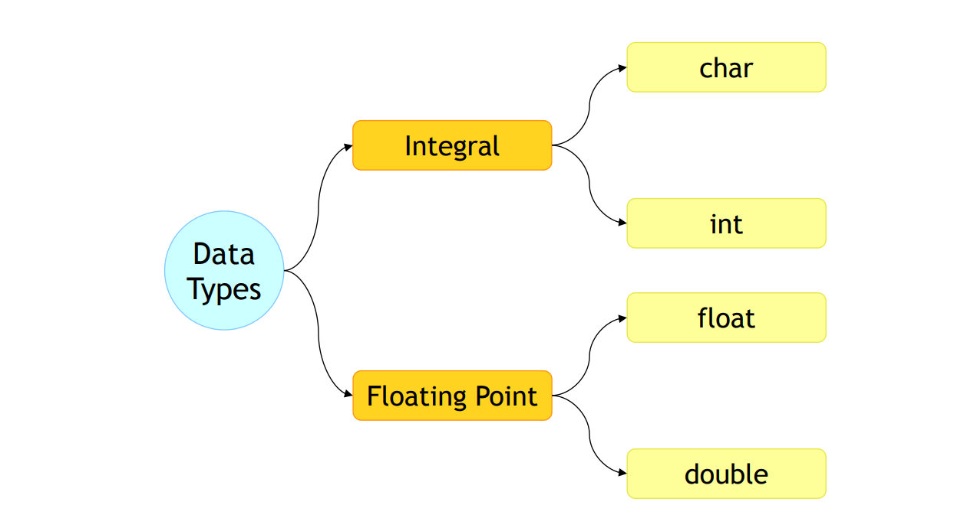
DATATYPES

Slide 9
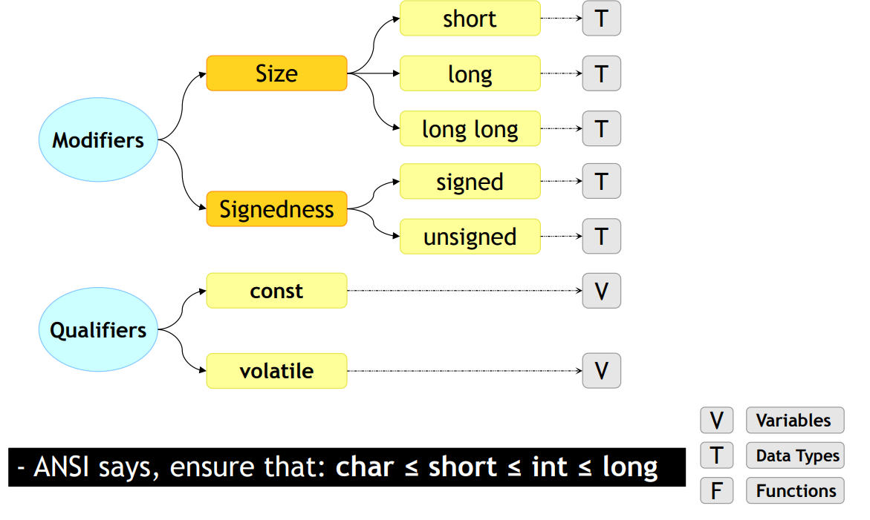
MODIFIERS AND QUANTIFIERS

Slide 10
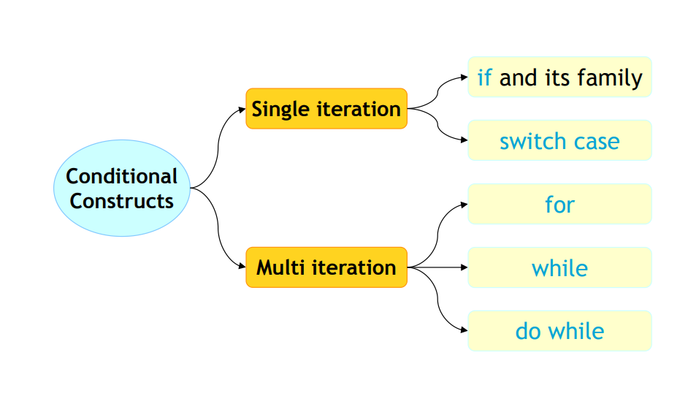
CONDITIONAL CONSTRUCTS

Slide 11
OPERATORS
Arithmetic
Relational
Logical
Bitwise
Assignment
Ternary
Overflow
Underflow

Slide 12
OTHER CONCEPTS
Arrays
Pointers
Functions
Strings
Storage classes
Pre-processors

Slide 13
AURDINO

Slide 14
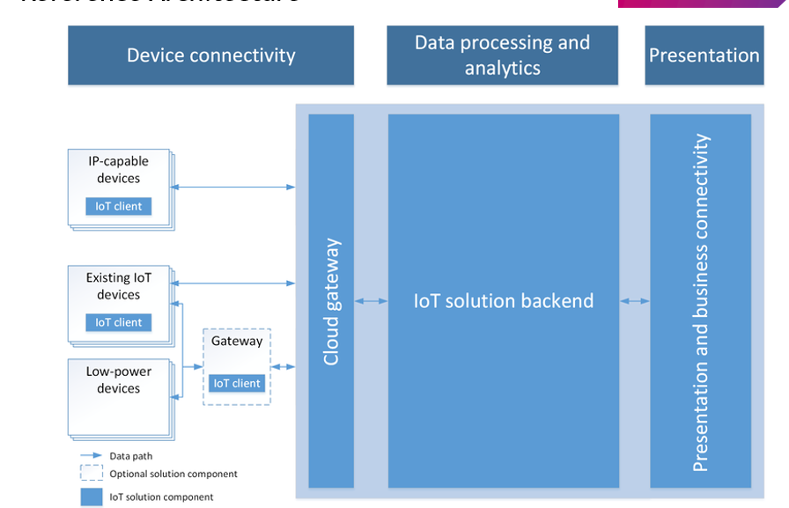
IOT
INTRODUCTION TO IOT
IOT ARCHITECTURE

Slide 15
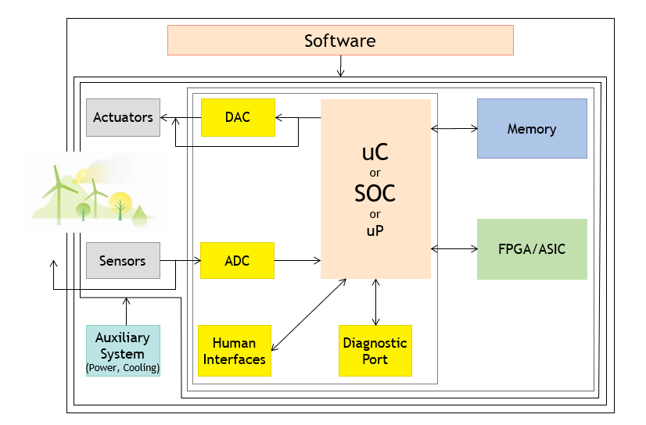
EMBEDDED SYSTEMS
Definition
Examples
Categories
Components

Slide 16
BUILDING THE UNITS – PERIPHERAL PROGRAMMING FOR PROJECT

Slide 17
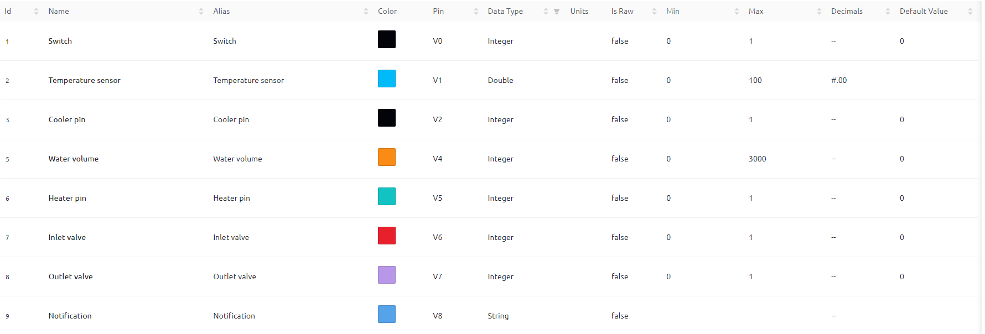
VIRTUAL PINS

Slide 18
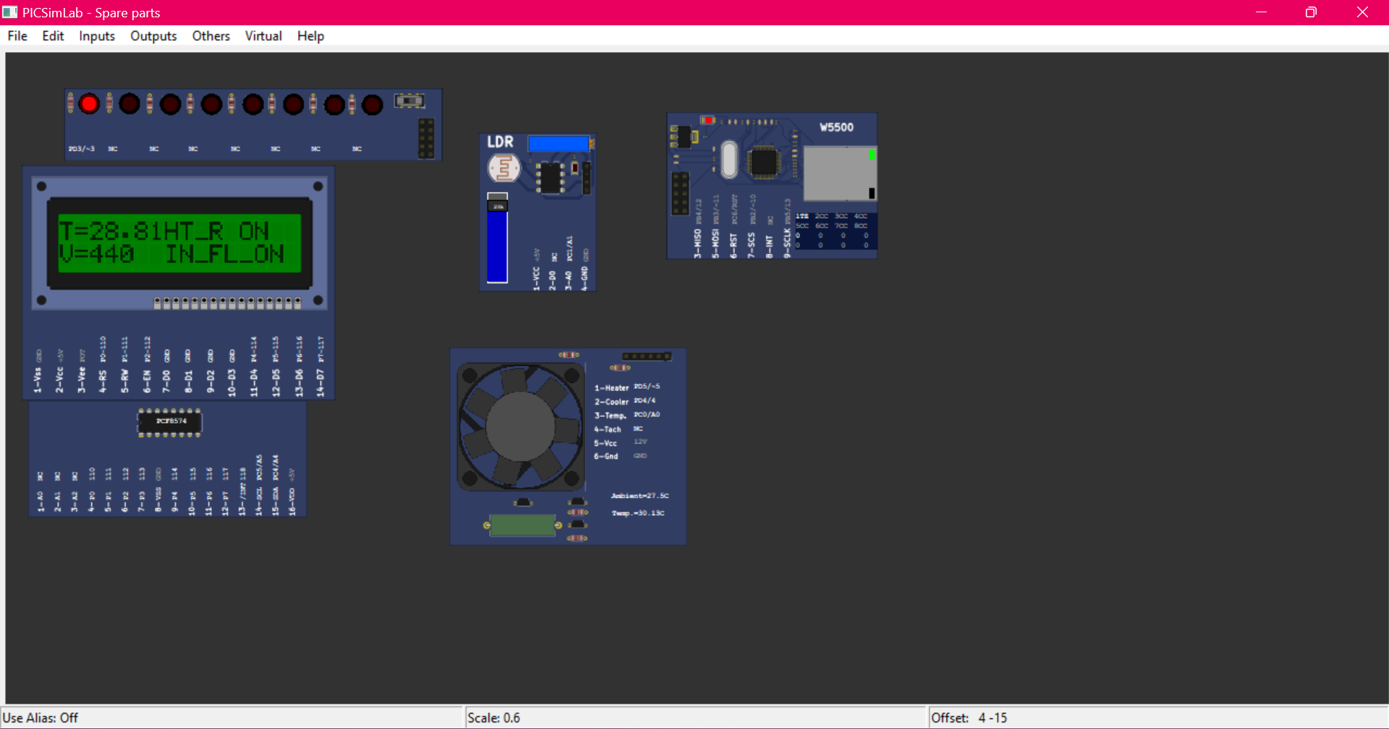
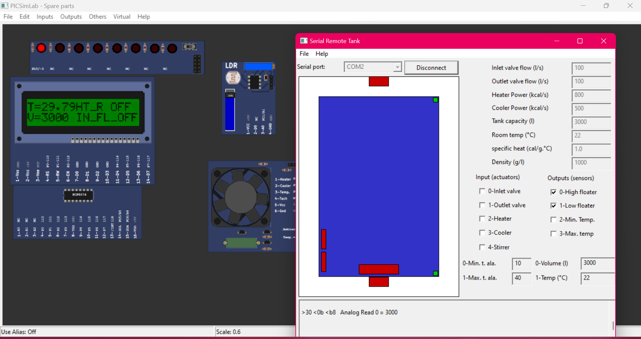

PICSIM LAB

Slide 19


PICSIM LAB

Slide 20
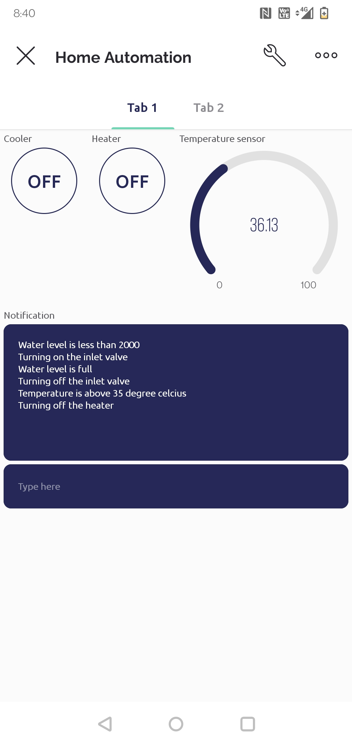
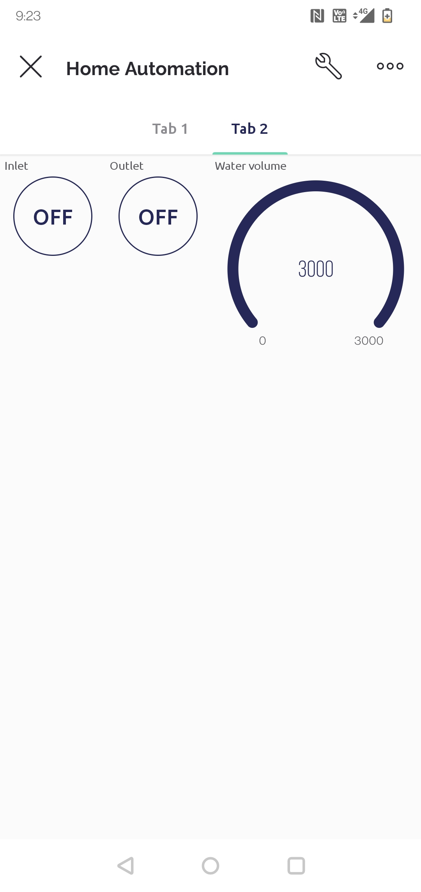
BLYNK IOT MOBILE APPLICATION

Slide 21
LIVE DEMO

Slide 22
DISHA WORKSHOP
Resume building
Opportunities in IOT
Career guidance

Slide 23
THANK YOU !!

